Slide 1
ePals: Where Learners Connect
Edith Wood ITEC 7445 Professor Roberts Summer 2014
By PresenterMedia.com

Slide 2
What is ePals?
Global Online Learning Platform
ePals is an online learning platform that connects millions of K-12 educators and students across the globe.
ePals provides quality common core content and facilitates collaboration among students and educators to create model 21st Century learning experiences.
21st Century Learning Experiences

Slide 3
How does ePals support the PCSD Technology Vision?
Emerging Technologies
Communication & Collaboration
Proficiency
Ethical Use
Through ePals, students will engage in project-based learning to foster 21st Century skills.
Through ePals, students work with individuals or groups outside the school to develop cultural and global awareness.
Through ePals, students will understand ethical issues surrounding technology and will engage in safe practices
Through ePals, students will select, use and troubleshoot a wide variety of digital tools and resources

Slide 4
More about vision
With the explosion of collaborative Web 2.0 tools such as ePals it is now possible to flatten our classroom walls in order to connect with other classrooms, cultures, business people, researchers, and other experts. Students have the opportunity to engage in authentic learning experiences without ever leaving the school. These experiences provide rich environments that allow students to explore and construct their own learning through project-based, interactive education which sharpens critical thinking skills and creativity. We believe that it is time for all stakeholders at North Paulding High School to explore ways to integrate real-life, project-based learning that challenges and engages students. Beginning with ePals is a giant first step.

Slide 5
What does it look like in the classroom?
EPals is appropriate for use in any K-12 classroom
Foreign language classrooms can connect with classrooms in the language being studied to learn about their culture and have opportunities to interact with native speakers
Science classrooms can collaborate to compare native plants with students on another continent.
Math classes can work with university professors to develop analytical and problem-solving skills
Social Studies classes studying WWII could connect with Japanese students to discover their country’s view on the war
World literature classes could connect with students in countries of authors they are studying to compare perspectives.

Slide 6
Providing Equitable Access to ePals
Teachers can reserve time in the computer labs or Media Center
The BYOT Policy and wireless access points allow student access to ePals through their own internet-ready devices
Students can access ePals on computers in the Media Center before and after school. They can also use computers during lunch or when given a pass to work in the media center
Students and teachers can log into ePals from home or community computers such as those at the public library as well

Slide 7
Let’s check off what we need to get started
The bare bones
For enhanced experiences
Computers with internet connection
Digital video camera
Digital camera
Printers
Scanners
Headphones with microphones
Skype (if we can get it unblocked)
The good news is we already own all of these items!

Slide 8
Technical Support at School
Your Peers
Your Local School Tech.
Your Media Specialist
Your Technology Committee
Your Students
The County Technology Dept.
If teachers are nervous about trying ePals they don’t have to go it alone.
There are many people in our school who are willing to help teachers get started and troubleshoot any issues.
Here is a snapshot of our support team.

Slide 9
EPals Help Center for Teachers
ePals also has a Help Center to assist teachers in getting started. It can be accessed here. Teachers can learn to
Create teacher accounts
Add student accounts
Add or change an avatar
Manage personal account settings
Manage student account settings
Step 1 Create an account
Step 2 Add students
Step 3 Manage account settings
Step 4 Manage student accounts

Slide 10
Let’s Talk Safety
“At the heart of the ePals Distributed Learning Platform is an innovative set of patent-pending role-based permissions and policy management technologies that empower schools and educators with the ability to create multiple learning experiences and manage (not just control) what students see and with whom they engage through the platform. ePals' industry-leading policy management technology fully implements regulatory frameworks, such as COPPA (Children's Online Privacy Protection Act) and FERPA (Family Educational Rights and Privacy Act), while enabling collaboration for real-world learning.”
From EPals Corporate

Slide 11
Cost Analysis
Secure communication
Easy access to classrooms across the world
Customizable student settings
The opportunity to collaborate, analyze, evaluate, and create in an open platform
Minimal training needed to get started
You may be thinking ePals has to cost a bundle!
Guess what . . . ePals is

Slide 12
How does ePals help us meet standards?
ePals is searchable by subject, age group, language, type of collaboration, duration and most helpfully, standards.
Most of the projects have standards listed. Standards from classrooms in other countries can be adapted.
It is easy to create your own projects aligned to standards you are addressing.
There is a screenshot of the standards from a high school English literature project on the next slide.

Slide 13
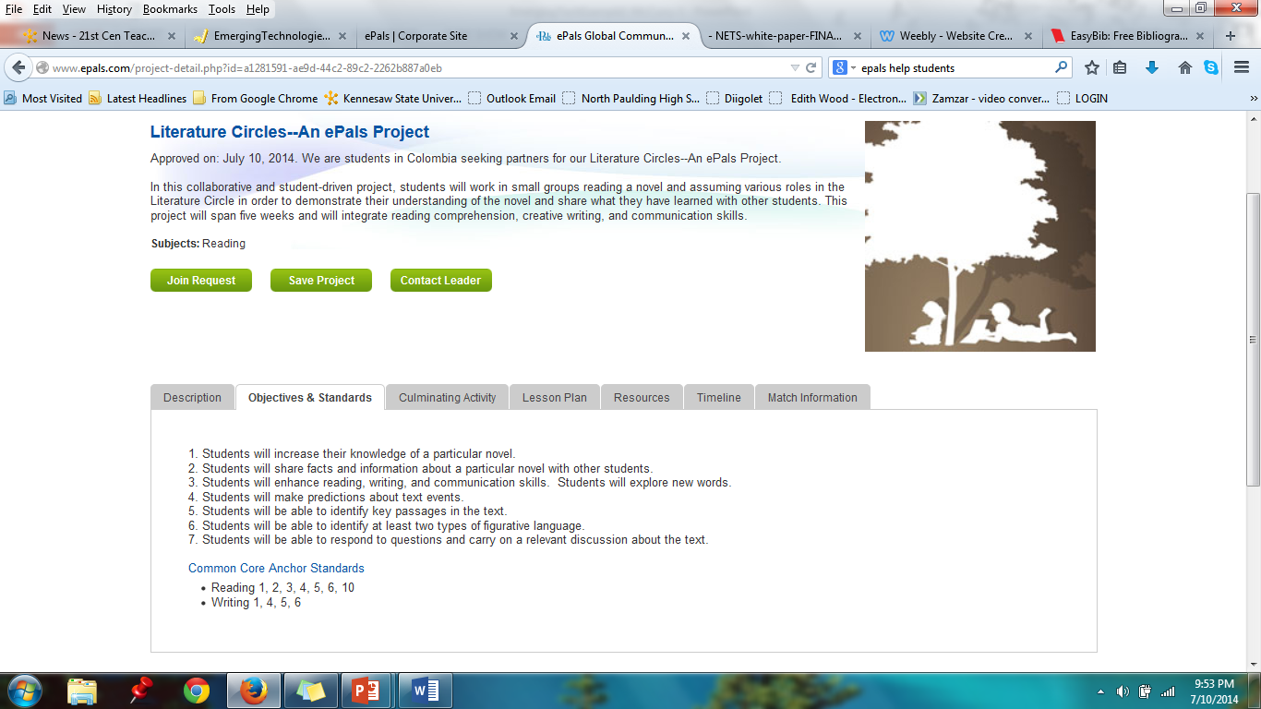

Slide 14
ePals helps reach learning goals!
ePals helps teachers incorporate many engaged learning indicators
Projects are standards-based and challenging
Learning is authentic, student-directed, multi-disciplinary, and culturally responsive
Students are explorers and teachers may be facilitators, guides, and/or co-learners
Activities are built on collaboration within and outside the classroom
Assessments can be performance-based, ongoing, and/or generative

Slide 15
ePals helps reach technology learning goals!
ePals helps teachers plan lessons that reach high Levels of Technology Integration (LoTI)
There are 6 LoTI levels from non-use (Level 1) to Refinement (Level 6)
ePals easily allows lessons to reach up to Expansion (Level 5)
Technology access is extended beyond the classroom
Technology is infused in the classroom
Technology-based tools are used routinely
Technology is seen as a tool to engage in authentic problems related to a theme or concept

Slide 16
ePals makes differentiation easy!
By encouraging group work
Students can work in small groups or individually
Students can be allowed to chose their own partners
Students can be grouped by ability
Students can be grouped with peer mentors
Groups can be local or abroad
By varying the content
Students can select tasks at their cognitive level
Students can select tasks at their interest level
By collaboration with peers
Feedback is more immediate and made by peers
Learning is student-led instead of teacher-led

Slide 17
ePals makes communication easy!
ePals is all about communication and collaboration
“The ePals Global Learning Community includes some thirteen million students and teachers in 200 countries, making it the largest online community in K-12 education.” (Boss, 2008)
Classrooms can connect across the hall, across the district, across the country , or across the oceans
Parents, support personnel, and administrators can join projects, too!

Slide 18
What does the research say?
Hoeflinger (2012) states, “As individuals who live today in a world of ever-growing global interdependence, students need to be prepared to compete in a global society. They require an increased knowledge of geography and a deeper understanding of world cultures and politics to compete successfully within the global community. Unfortunately, studies conducted as recently as 2011 have shown U.S. students to be deficient in these areas. Only 25% of U.S. students passed the latest NAEP test, placing them well below students from other countries.” She goes on to mention ePals as one solution to address this problem.

Slide 19
What does the research say?
Electronic Resources for Schools (2011) “highly recommend[s] that districts and schools provide ePals . . . opportunities for their educators. This is an excellent program that will allow much-needed collaboration and communication within the global community. Students will definitely enjoy the opportunity to interact with peers around the world. Teachers will be able to network and share with educators. ePals . . . provides a vital service to the educators who want to access the latest resources and tools in order to provide meaningful learning experiences to their students. Highly Recommended.”

Slide 20
What does the research say?
Suzie Boss of Edutopia has this story to tell.
“What does global learning look like when it works well? We had one collaboration that involved schools in Kenya and New Jersey. Both schools were interested in water. They started with a project that used blogs. Students took pictures and analyzed questions about water: How far are you from a water source? Do you have to carry it? What about sanitation?
Then something really interesting happened. They kept the dialogue going after the water project ended. Students began discussing the upcoming elections. Kenyan students wanted to know about the possibility of what they saw as an African president in the United States.
Then the elections happened in Kenya, and the violence. That brought out a whole new set of issues. Students learned that there is a multiplicity of viewpoints, formed at least in part by where you live. So, here you began with a curriculum around global warming and water. Not only did you achieve those learning goals, but you also went on to see more communication about the issues and topics of the day. That's what twenty-first-century learning should be.”

Slide 21
Professional Learning is a Snap!
Professional Learning needed to launch ePals is minimal and can be accomplished this way:
Kick off can be conducted by the media specialist on a professional learning day.
If launched system-wide, all media specialists would need a training day before kick off. Since they do not get substitutes, no cost would be incurred.
Follow-up training can be done on an individual level by the media specialist and/or county technology coaches.
Follow-up could also be arranged during the 1 hour professional learning that occurs in each school once a month.

Slide 22
Reflection
I had heard of ePals many times during the past few years, but had never really taken a hard look at it. My 21st Century Teaching and Learning class led me to explore the site and I fell in love with it. It hits so many indicators of engaged learning and also a high LoTI level and is so intuitive and easy to use that I really can’t wait to introduce it to my teachers. Creating this PowerPoint proposal has made me analyze this tool in a much deeper way than I probably would have done otherwise. In the normal course of things, I would probably have just sat down with a few teachers I thought would be early innovators and then hope their success would spread the fire. Now I have a great proposal I can present to my newly formed technology committee and administrators. I hope to be able to present this at a staff meeting or on a professional learning day. It is always a gift to walk away from a class with something you can actually use on the job!

Slide 23
References
Boss, S. (2008, July 21). Global Learning: Connecting the World with ePals. Retrieved July 10, 2014, from http://www.edutopia.org/epals-online-community-pen-pals
Electronic Resources for Schools. (2011). Internet@Schools, 18(3), 29-32.
EPals, Inc. (2014). About Us. Retrieved July 10, 2014, from http://www.corp.epals.com/about-us.php
Hoeflinger, D. (2012). Teaching Students to be Global Citizens. Delta Kappa Gamma Bulletin, 79(1), 15.

Slide 24
First Class – World Class

